Slide 1
Ecossistemas de Empreendedorismo Universitário
Notes:
Presentacao:
Empresaria, Gene-Blumenau, Blusoft. Comunicacao para incubadoras de empresas.
Mestrado em Promocao e Capacitacao de pequenas empresas, SEPT.
Tec de MTY: diretora carrera LDE em campus QRO, diretora departamento de emprendedorismo, diretora regional IEEGL. Tec, uma grande escola: ranking Princeton.
Doutorado: educação em emprendedorismo.

Slide 2
Tec de Monterrey em números
26 câmpus no México
18 sedes al redor do mundo
92,645 estudantes
27,469 educação secundária
58,364 educação superior
6,812 pós-graduação
48% estudantes com apoio financeiro
10,013 professores
2,377 tempo completo

Slide 3
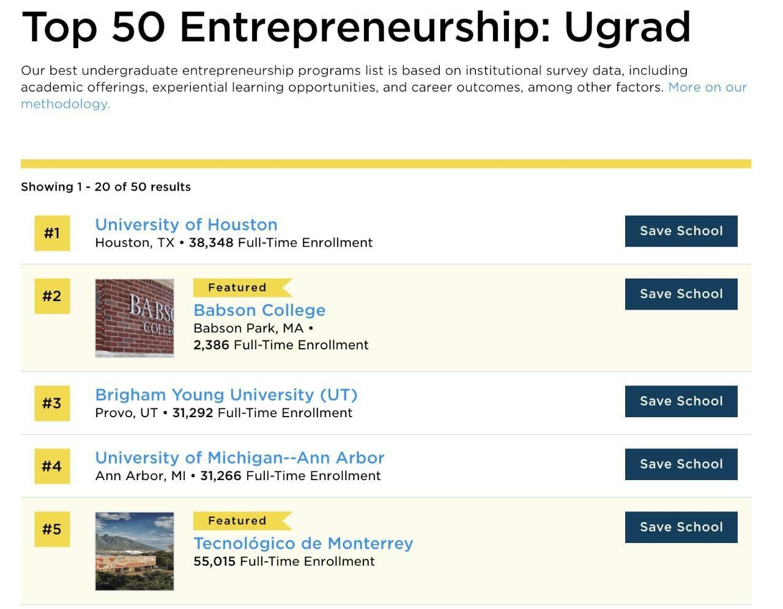
Tec de Monterrey em números
Visión al 2025: Liderazgo, innovación y emprendimiento para el florecimiento humano
71,6% dos estudantes participaram em alguma atividade de empreendedorismo curricular ou extracurricular (2020 – 2021) 18,8% dos estudantes são sócios ou estão incubando uma empresa até três meses depois da graduação (maio de 2019)

Slide 4
Viver com ambição
Universidades como centro de inovação e desenvolvimento por meio do empreendedorismo.
Notes:
O empreendedorismo é uma disciplina que, em sua natureza, convida todos os seus atores a viver com ambição. Universidades como centro de inovação e desenvolvimento por meio do empreendedorismo.

Slide 5
Condiciones para o empreendedorismo universitário
Cursos
Palestras
Incubadoras
Ecossistema?
Notes:
Para atender a essa demanda da sociedade, as universidades surgiram uma série de iniciativas: temas, concursos, etc... Mas o que é necessário para um conjunto de iniciativas é transformado em um ecossistema... Cursos de Empreendedorismo vs. Empreendedorismo Ecossistemas de empreendedorismo.

Slide 6
Um ecossistema...
Entrepreneurial ecosystems represent the
social, cultural, political and economic context surrounding, supporting and influencing entrepreneurs
(Neck et al., 2004).
Notes:
Entrepreneurial ecosystems represent the
social, cultural, political and economic context surrounding, supporting and influencing entrepreneurs
(Neck et al., 2004).

Slide 7
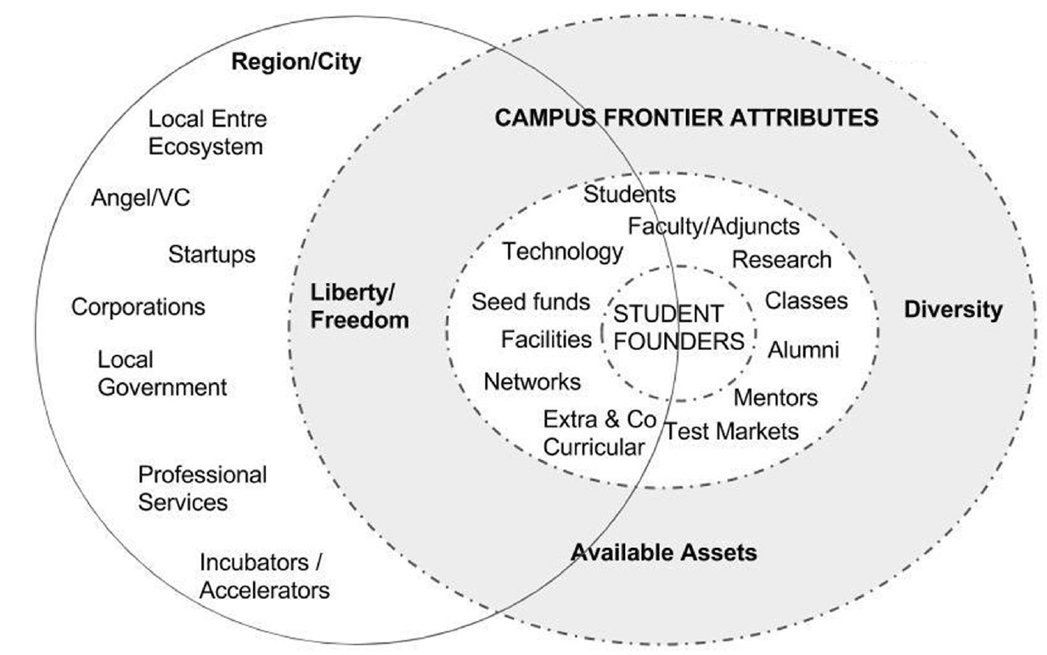
Ecossistema de Empreendedorismo de uma Universidade
Miller and Acs (2017)
Notes:
Miller & Acs (2017) define the university entrepreneurial ecosystems through a lens of frontier attributes that function as enablers for the growth of the entrepreneurship within the university campuses. These frontier attributes are: Liberty/freedom, diversity and available assets. Liberty or freedom represent the ability of students to freely choose the courses and extracurricular activities, the freedom of decision-making and options today’s students have in terms of international transfers, research, etc. Diversity is represented by a number of demographic factors, but also fields of study, visiting faculty and students, political ideologies, etc. The available assets can be perceived in terms of courses and educational programs, alumni, professors, labs, networks to other institutions and many more. The various actors and factors within the entrepreneurial micro-ecosystem as well as the interconnectivity of the micro-ecosystem with the regional ecosystem are visible in Figure 2.

Slide 8
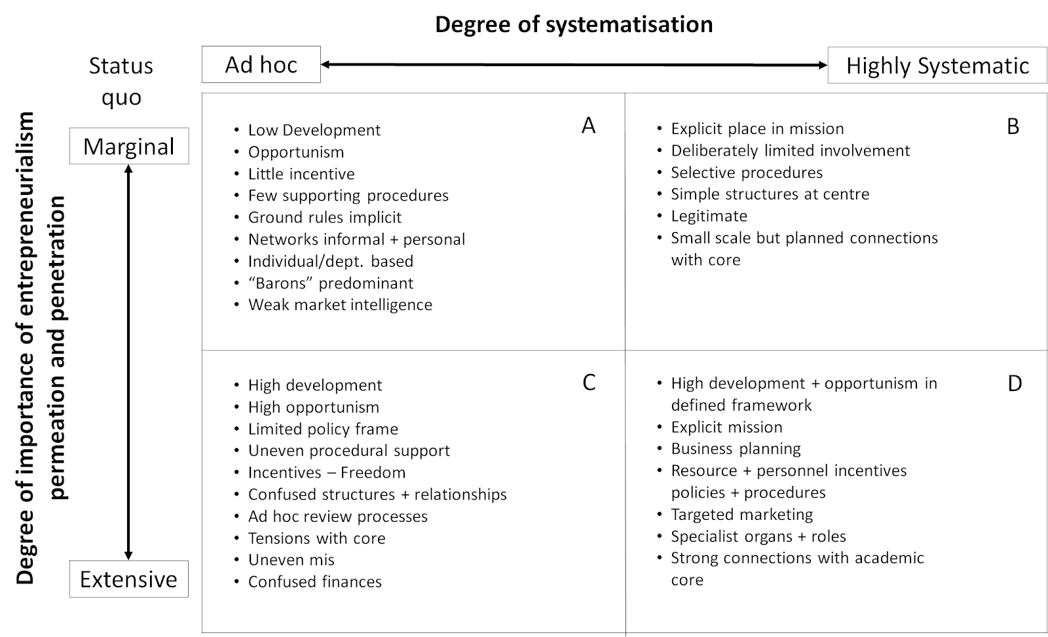
Development of Entrepreneurial Culture (Davies, 2001)
Notes:
The entrepreneurial ecosystem at the university is deeply connected with the entrepreneurial culture, that the institution fosters and develops within the campus. The understanding of the development of such culture helps understand the level, at which the university campus functions, as well as coin a strategy for the development of the ecosystem itself. In figure 3, a theoretical framework of such systematisation is presented (Davis, 2001).
Within this framework, the two variables are degree of systematisation of the entrepreneurial activity, and the degree of importance of entrepreneurialism at the university. The degree of importance defines, how well is the entrepreneurship orientation within the university developed, from marginal, scarcely organized activities, to an extensive number of activities and linkage of entrepreneurial development to the everyday life at the campus. On the other hand, the degree of systematisation refers to the way these activities are organized within the campus. The Ad hoc, or low degree of systematisation, refers to the more localised and primitive initiatives, often individual or on a department (school) level. The high degree of systematisation is connected to top-down, and leadership supported orientation of entrepreneurial activities and culture within the university structure. This understanding provides us with a framework that allows us to further analyze the entrepreneurial ecosystems at a university level, and their connection to the outside, external entrepreneurial ecosystems.

Slide 9
Ecossistemas de Empreendedorismo Universitário
Ján Rehák & Miguel Angel Rodríguez
Notes:
Ferramenta Miguel/Ján.

Slide 10
Empreendedores Detonar atividade empreendedora
Startup na fase de comercialização e investimento
Startup na fase de ideação
Startup na fase de lançamento
Ján Rehák & Miguel Angel Rodríguez

Slide 11
Talento Enriquecendo equipes de negócios
Experiência Local/Universitária
Experiência internacional, graduação
Experiência internacional, pós-graduação
Ján Rehák & Miguel Angel Rodríguez

Slide 12
Expertos Proporcionar conhecimento e experiência às equipes empreendedoras
Mentores e apoio em pesquisa básica
Pesquisadores, consultores de alto nível
Transferência de tecnologia, centro de pesquisa, coaching
Ján Rehák & Miguel Angel Rodríguez

Slide 13
Serviços de suporte Facilitar o processo de lançamento de empresas
Espaço de trabalho, capital inicial, fornecedores locais
Coworking, angel investors, serviços de back office
Escritório para empresas, venture capital, maker spaces, convênios internacionais
Ján Rehák & Miguel Angel Rodríguez

Slide 14
Formação Dar aos empreendedores instrumentos, ferramentas e conhecimentos para o desenvolvimento do projeto empreendedor
Atividades básicas, conferências, concursos de ideias.
Incubadoras de empresas, competições de startups
Aceleradoras, competições internacionais, programas de mentoria
Ján Rehák & Miguel Angel Rodríguez

Slide 15
Cultura e experiência Incentiva e promove a colaboração entre equipes de empreendedores, bem como incentiva a conexão entre atores do ecossistema
Eventos de networking espontâneos, entusiastas do empreendedorismo
Eventos oficiais de empreendedorismo, grupos de empreendedorismo estudantil
Apoio institucional, educação empreendedora transversal, convênios institucionais
Ján Rehák & Miguel Angel Rodríguez

Slide 17
Região/cidade
Campus
A importância das alianças com atores externos: quanto mais à beira do gráfico, maior a possibilidade de que os atores do ecossistema estejam fora dos muros da universidade.

Slide 18
Figure 5. Relationship of University’s Schools and Stakeholders and its impact on Region’s development
Source: authors
Notes:
In this sense, universities may play the role as anchor institutions of regional innovation systems, since they have a clear social purpose and offer formal and informal support for development (Culkin, 2016). The impact of entrepreneurial universities in regional development has been too focused on the creation of students´ enterprises (Miller & Acs, 2017) and we argue that an holistic approach is necessary. Universities and their entrepreneurial ecosystems foster the development of entrepreneurial skills and attitudes as well as new venture creation. As Galvão et al. (2018) observe, universities use entrepreneurship education programs that develop students´ entrepreneurial spirit. They may lead to new venture creation, but they also impact in the development of other career paths (Jones et al., 2017).
If we argue that the contribution of entrepreneurial universities to regional development goes further than just enterprise creation, we must discuss the metrics that we use to measure this effect. Traditionally, technology transfer metrics are the primary way that universities demonstrate their contribution to economic development, but it is a rather limited metric if we want to demonstrate the role played by university in talent development, for example. Walshok and Shapiro (2014) propose that entrepreneurial universities contribute as a function of culture, commercializations supports, talent development and connections with a diversity of industries. Finally, we must take into account that different stakeholders will have different interests and objectives, and the metrics should reflect that. For example, university leadership cares for reputation and rankings, faculty and student recruiting, and research funding; while business incubators and accelerators look for number of startups formed and dollars of capital raised (Huang-Saad et al., 2018).

Slide 20
Nenhuma história humana é escrita sem a presença de uma ou duas mãos amigas que se estende em nossa direção

Slide 21
Gracias
Rafaela Diegoli rdiegoli@tec.mx
https://ciie.itesm.mx/

